Slide 1
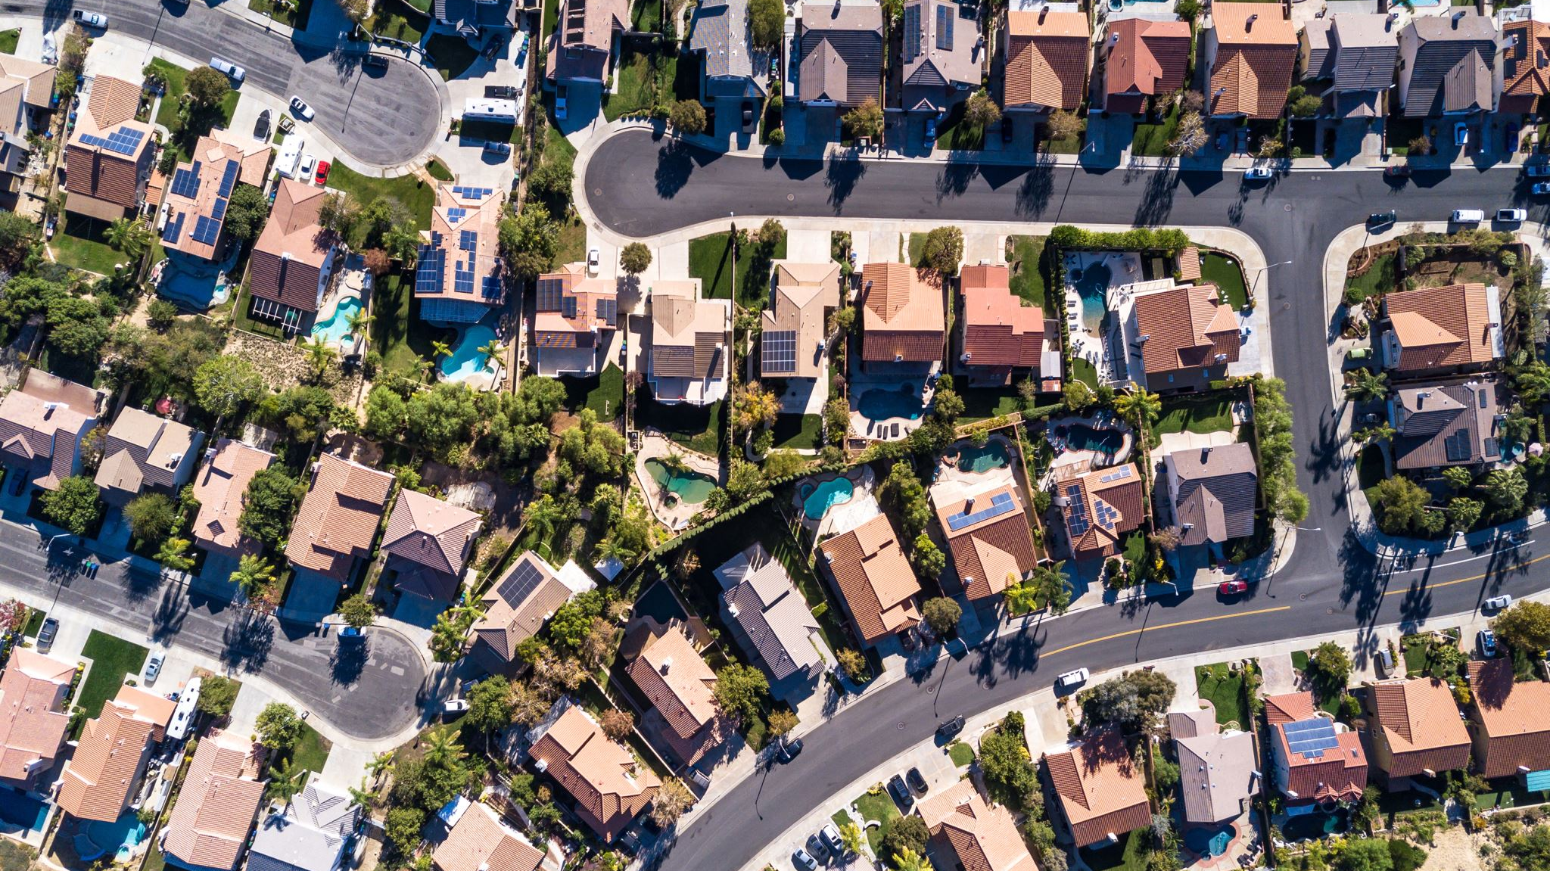
Examining the Impact of Crime & Demographics on Housing Affordability in Los Angeles
IST 718
Professor Lando
By Khalil Robinson & Amanda Norwood

Slide 2

Introduction
City of Los Angeles is developing a tool to help migrants with their move
The project focuses on the relationship between crime and housing affordability
Examines how demographics and education can impact pay and affordability
Identify drivers for price of homes

Slide 3

Specification
Identify the relationship between crime and housing costs
Identify neighborhoods are both safe and affordable
Determine how a person's profession, gender, and education level impart their salary
Predict zip codes where people can live based on their demographic data
Predict 2023 house prices based on available data

Slide 4
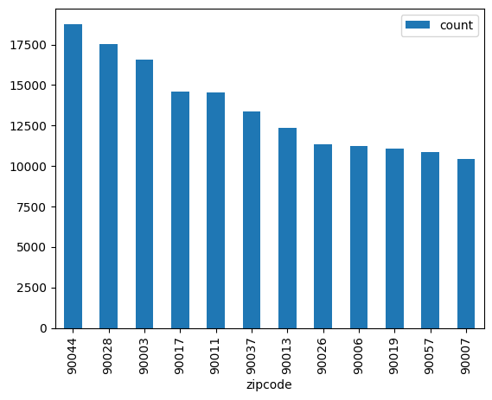
Top ten zip codes for crime
These zip codes had the most crime committed since 2021
Range varies widely

Slide 5
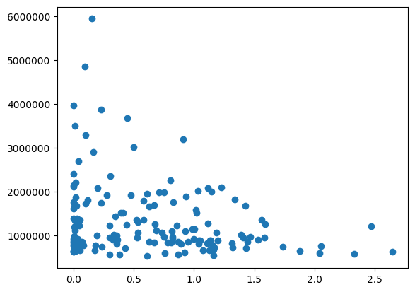
House prices and crime percentage
Non linear relationship
High crime tend to have lower house prices
Lower crime vary widely

Slide 6
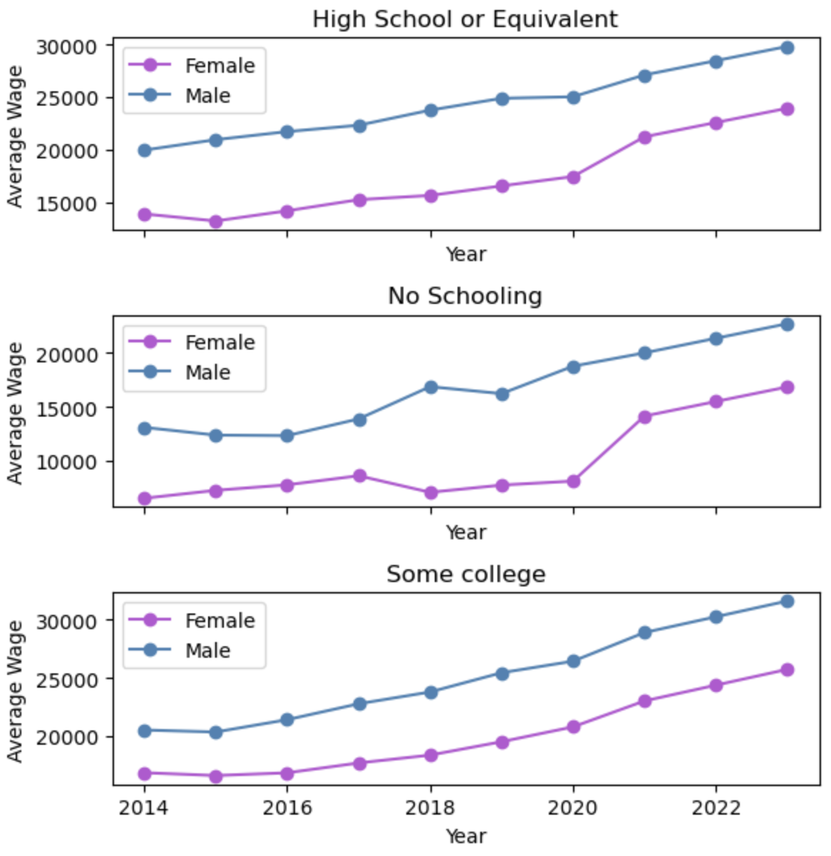
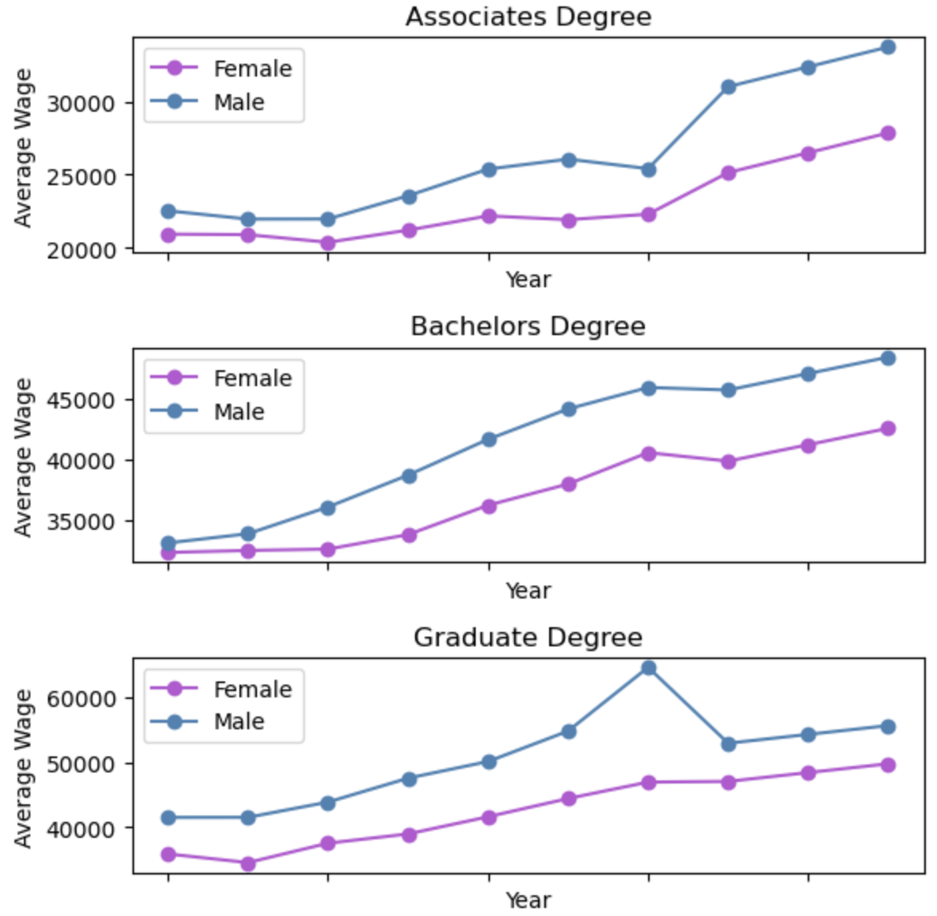
Education & Salary by Gender
Notes:
In LA, men outearn women.
In some cases such as associates degree and bachelors degree, you can see the pay gap is slightly expanding. But for graduate degree, it’s becoming tighter.

Slide 7
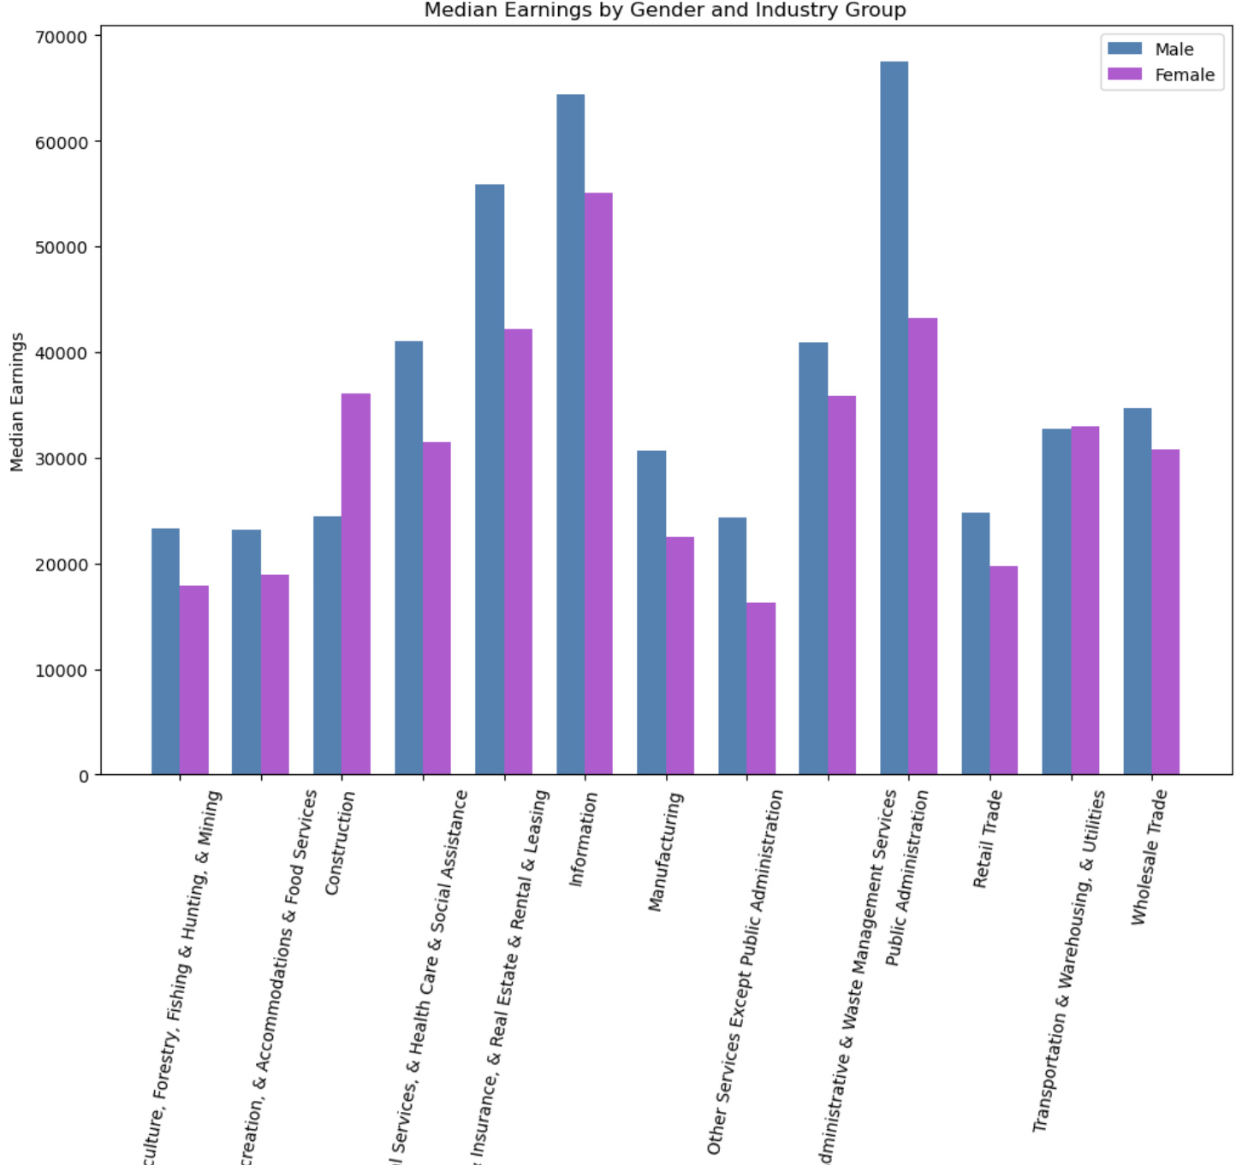
Salary by Gender
Notes:
Another view by profession—women outearn in the construction and transportation/warehouse field. Some fields are tight while others show a huge pay gap.

Slide 8
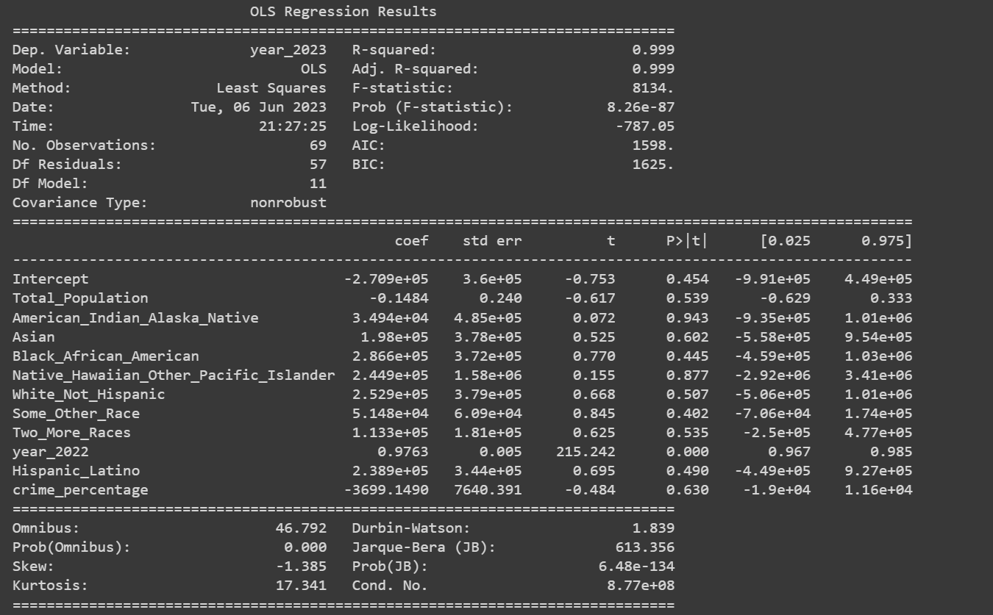
Linear regression for 2023 house prices
These variables account for 99% of the variability
Crime has a negative affect
According to the model African Americans has the greatest positive impact on price

Slide 9
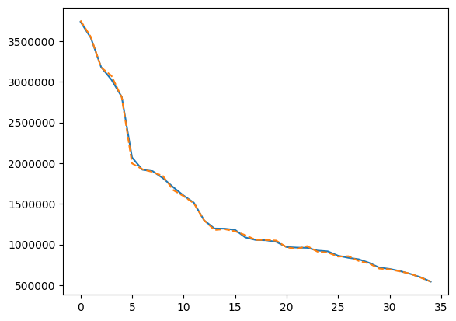
Predicted vs Actual
Accuracy on the actual

Slide 10
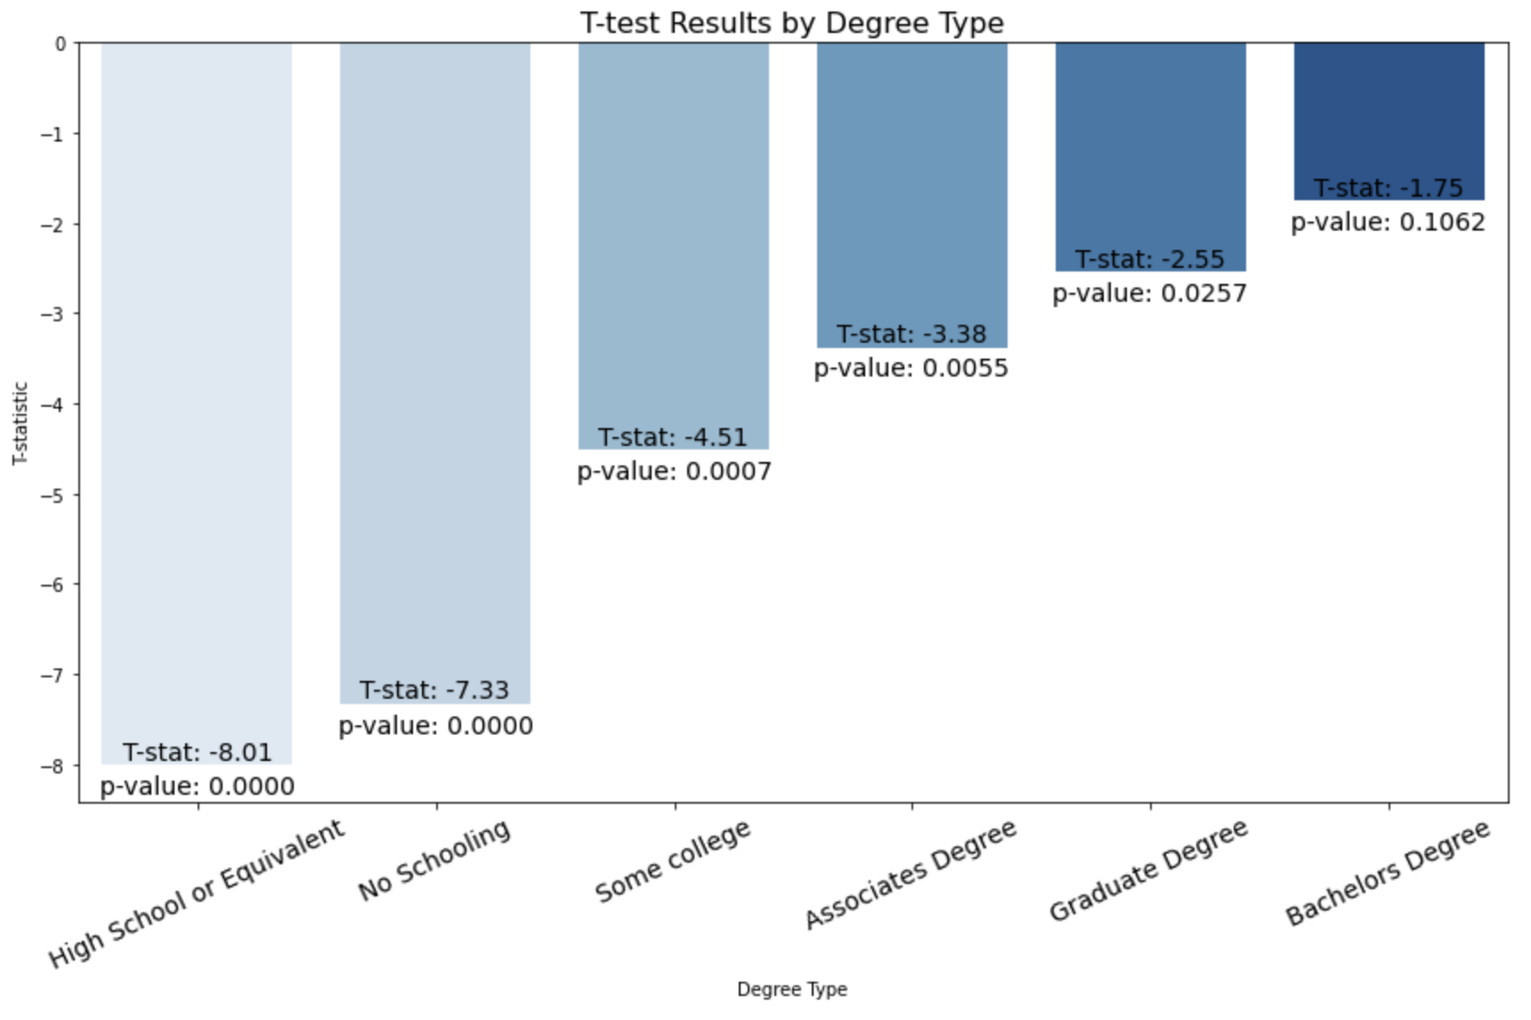
Analysis – T-Test for Degree Types
T-Test: measures the difference in means of two groups.
Hypothesis: no difference in salary between men and women
Alternative hypothesis: there is a difference!

Slide 11
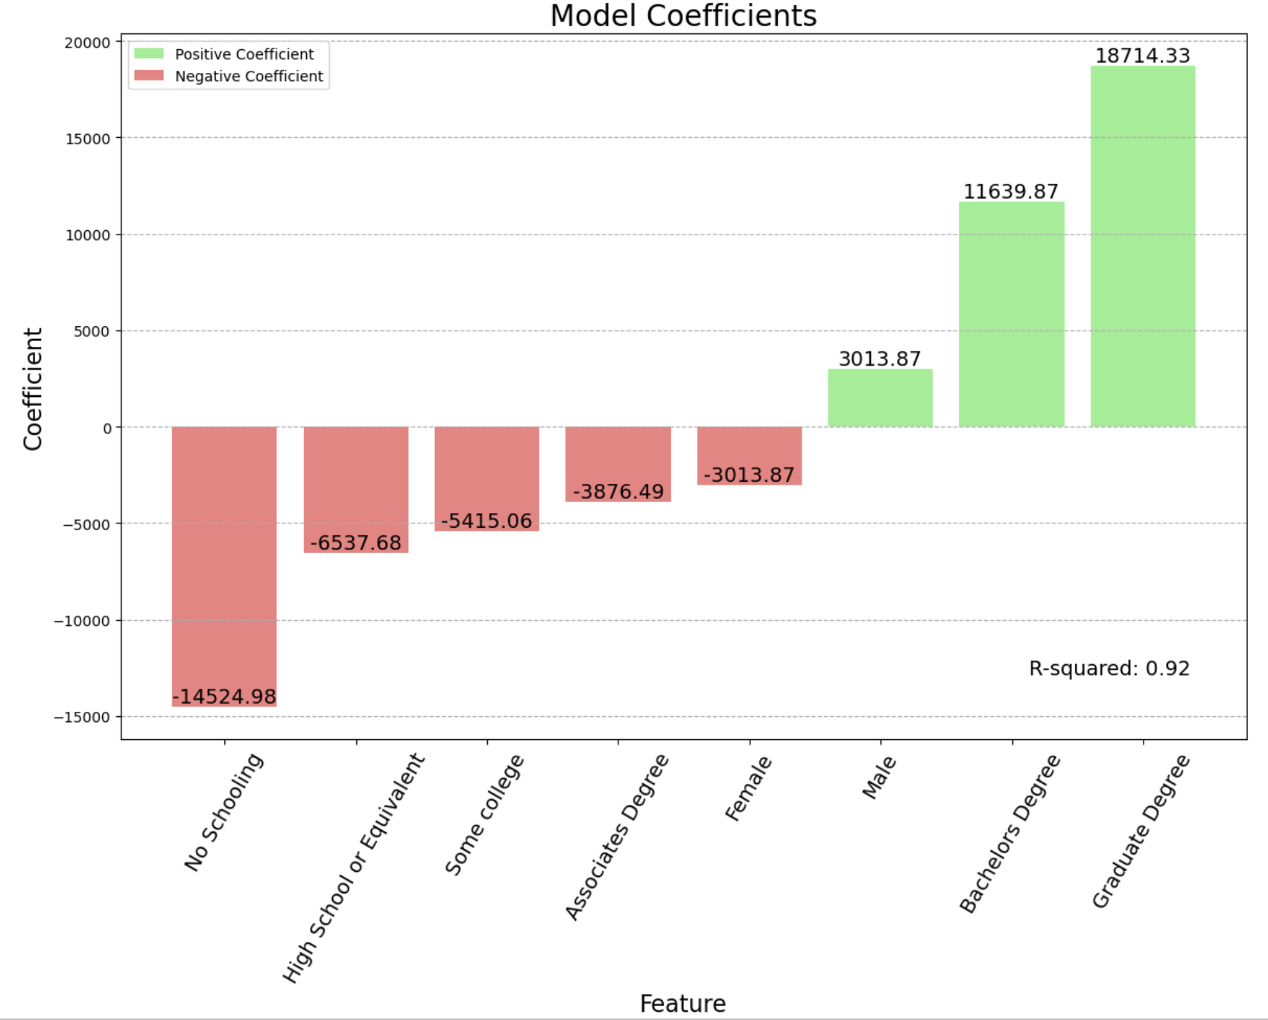
Analysis – Linear Regression
Independent variables: gender and degree type
Dependent variables: average wage

Slide 12
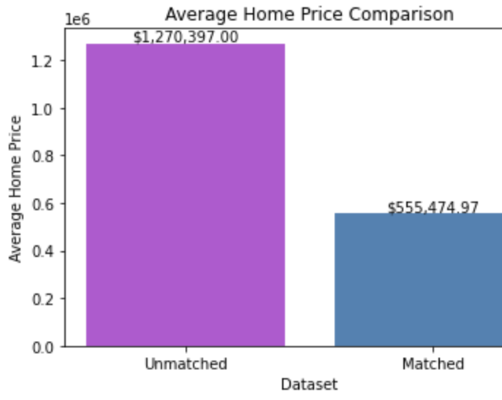
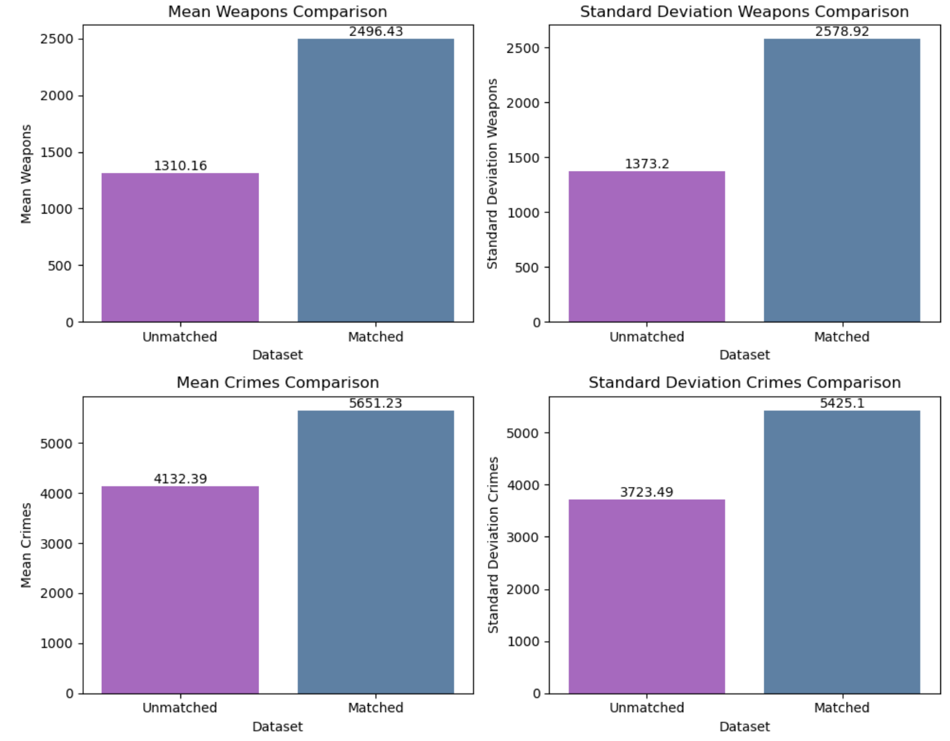
Housing Affordability and Crime
Matched professions by affordable housing
We calculated affordability based on 3x a professions salary
Crime rate comparison:
Compared rates between matched and unmatched zip codes

Slide 13
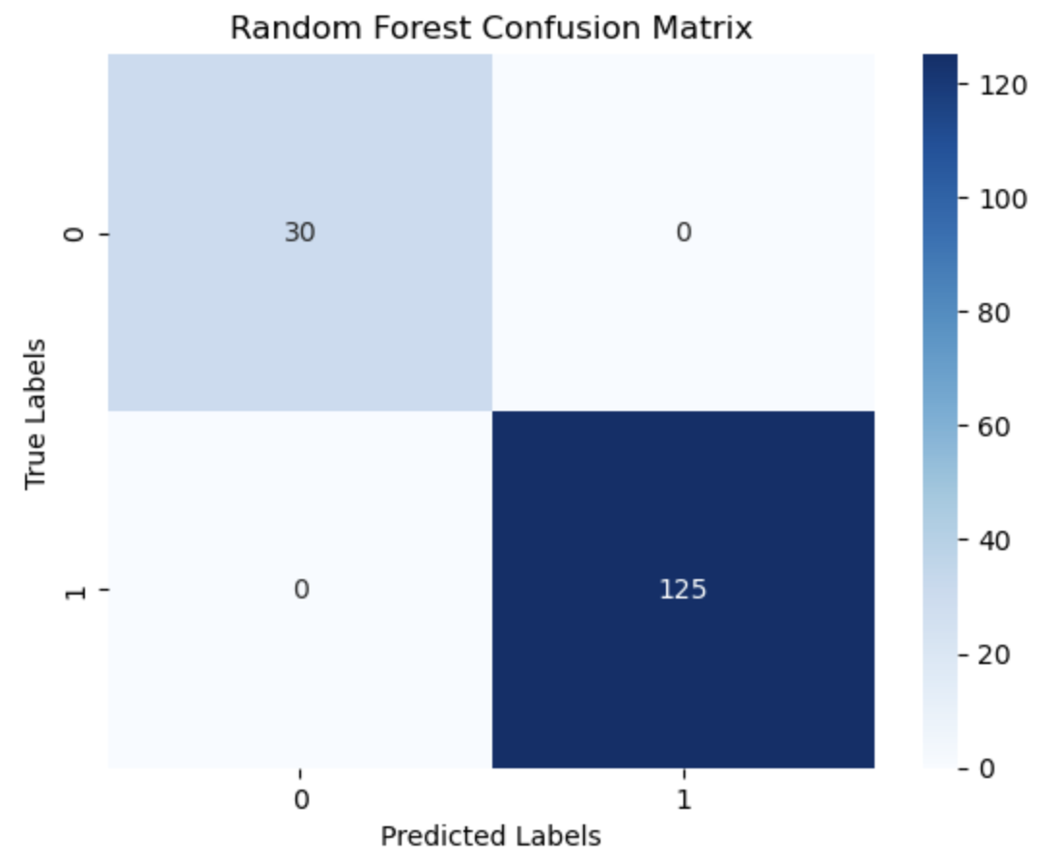
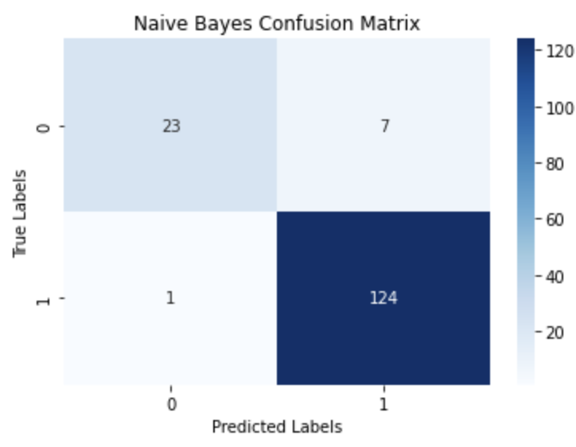
Analysis – Random Forest & Naïve Bayes
Predict classes of matched and unmatched zip codes
100% accuracy
94.84% accuracy

Slide 14
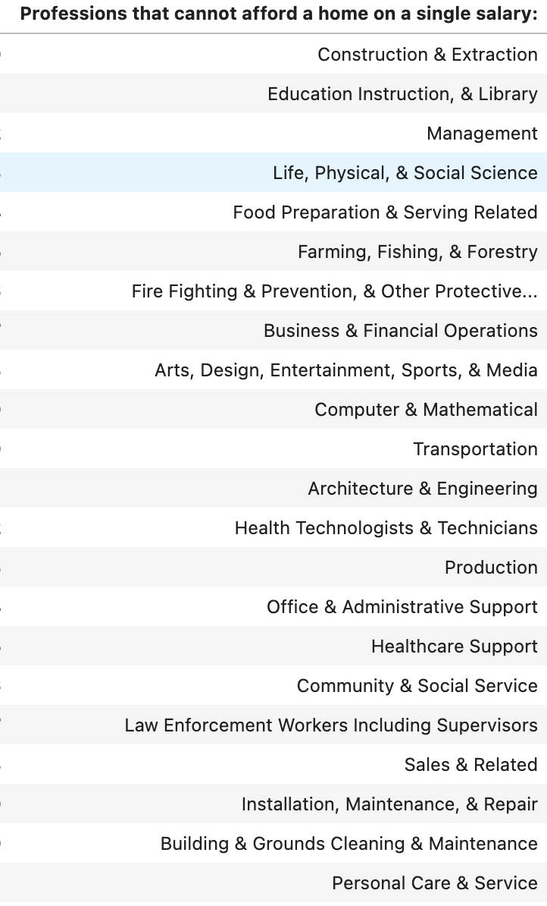
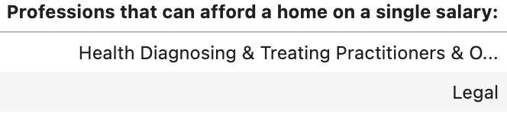
Results – Which professions can afford on a single salary?

Slide 15

Recommendations for Potential LA Migrants
Salary Negotiation
Be aware of potential gender disparities
Degree & Profession
Take into consideration the reported average wages
Housing Considerations
If safety is a top priority, then consider the option of living with roommates or purchasing a home with another person

